Slide 1
Programming training (3)
Chun-Yuan Lin

Slide 2
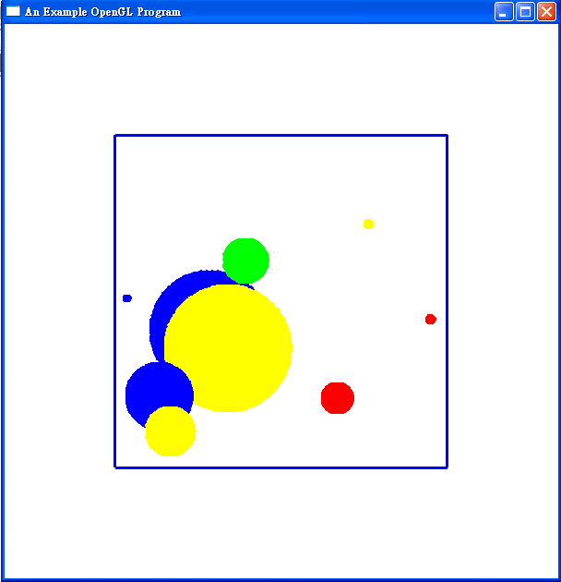
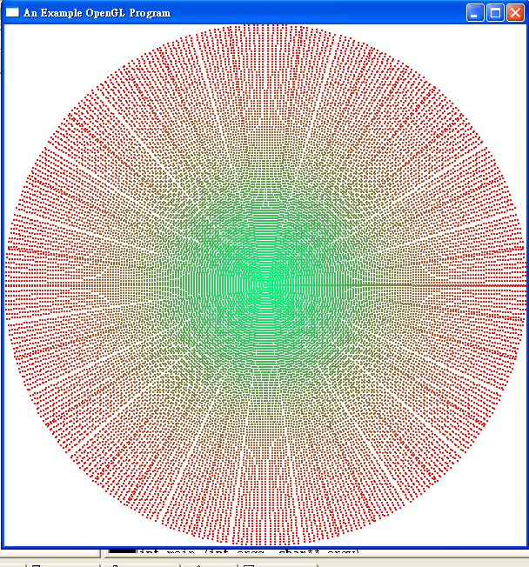
Hint: (1.0, 0.0, 0.0), (0.0, 1.0, 0.0), (0.0, 0.0, 1.0), (1.0, 1.0, 0.0), (1.0, 0.0, 1.0), (0.0, 1.0, 1.0)
Requirements: Generate 20 circles; each with random center, length and selected color under the boundary (400x400), circle can be overlapped with each other.
(Hint: 100 circles, initial color: (1.0, 0.0, 0.0), decrease RED and increase Green and Blue, the increase rate of Blue is half of the increase rate of Green)

Slide 3
Training 3
Please send the Source code file (*.c or *.cpp) to me (cyulin@mail.cgu.edu.tw) before 10/28, 23:59:59.
Please annotate your name and your student ID in email.
  The file name is “student ID”. If more than one files, the names are “student ID-1”, “student ID-2”, etc.
  Please compress the file(s) to a .zip or .rar file. The file name is “student ID-train3”.
  For example, a student has ID “A0000001” and two source code files. The source code file names are A0000001-1.c and A0000001-2.c and the compressed file name is A0000001-train3.zip.
The files will be rejected without following the rules.
.

